Slide 1
JINA
THE REASON YOU’LL OWN NFTs

Slide 2
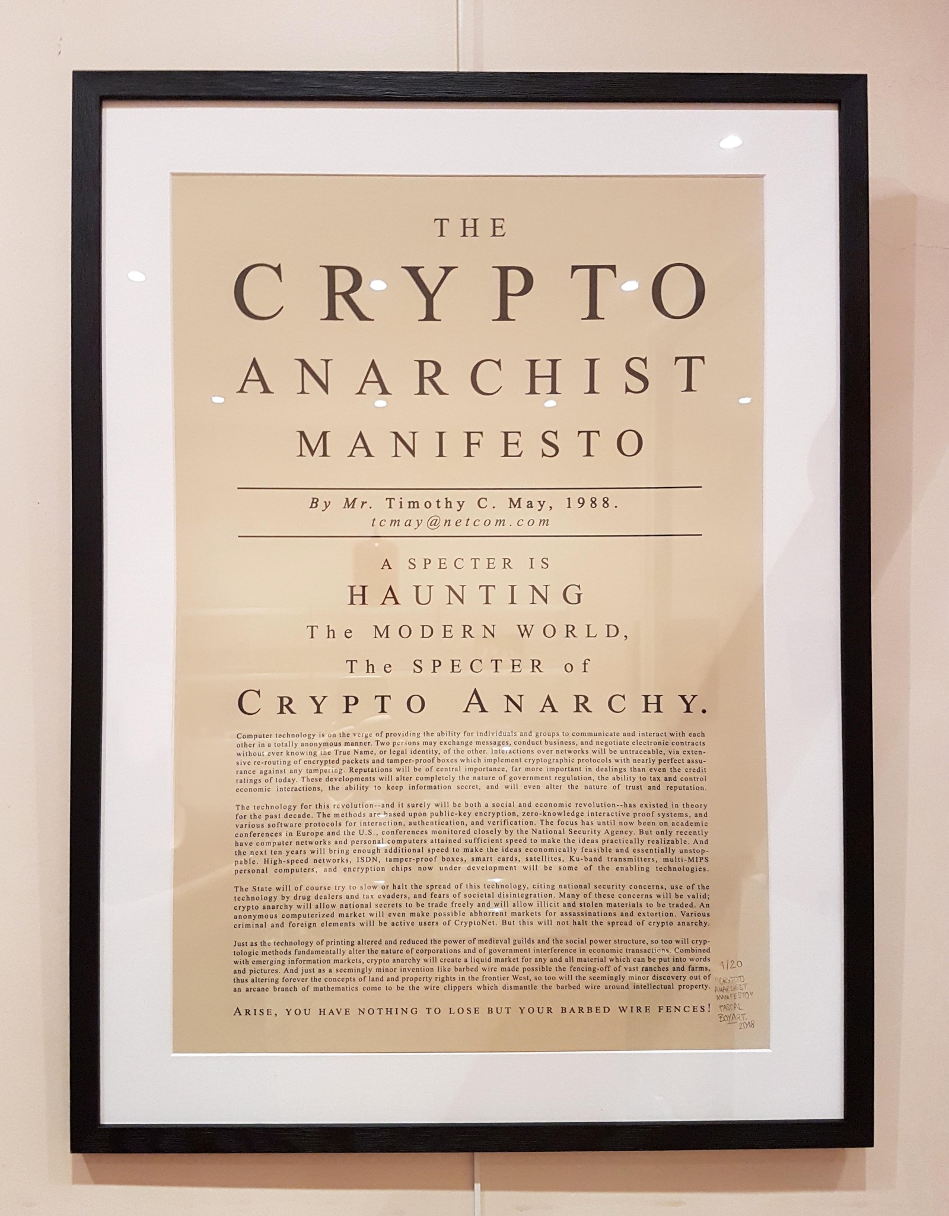
“...create a liquid market for any and all material which can be put into words and pictures.”
—Timothy C. May

Slide 3
The problem
Major DeFi protocols function by, storing collateral assets in an escrow account:
That means, only a selected number of assets are used as collateral.
And assets that require KYC couldn’t easily be collateralized.
We have come up with a solution, that allows any asset in Algorand to be collateralized.

Slide 4
The solution
To allow any NFT asset in Algorand being used as collateral:
The dapp must not discriminate among assets.
Lenders decide which assets can be used as collateral. (this is needed to prevent borrowers collateralizing high risk assets which might cause liquidation lose)

Slide 5
The solution
Jina did both by creating a pseudo order-book that matches borrower and lenders
Using algorand’s asset admins to manage collateral assets.
And liquidity providers selecting which assets are allowed to be used as collateral.

Slide 6
How Jina solves it?
Asset admin
Delegated LogicSig
Using algorand’s freeze & clawback asset. Any NFT can be used as collateral, as long as it gives admin rights to Jina smart contract.
Lenders select which NFTs have permission to withdraw. Thus, incentivises to protect loan supply (liquidity).

Slide 7
Jina operation
Let’s see a demo in action
Video: Demo video

Slide 8


Using Jina demo (as NFT creator)
Manager,
Freeze &
Clawback
Step 1
Step 2
Connect wallet
Transfer admin address to Jina

Slide 9
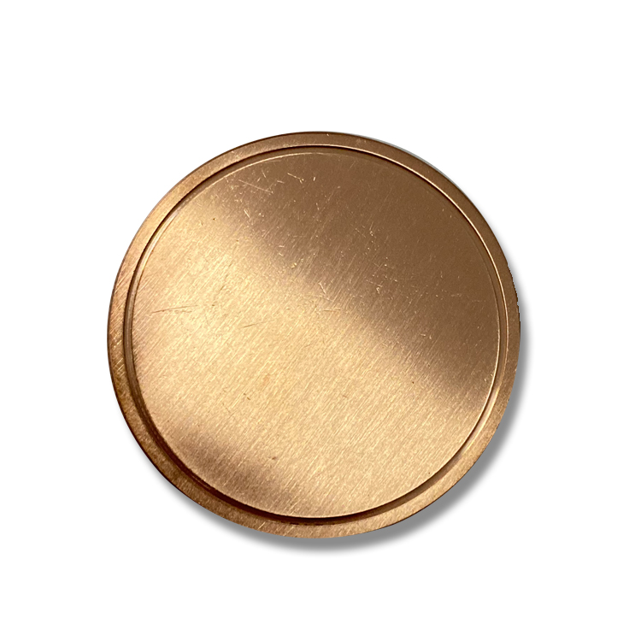
Using Jina demo (as borrower)
Step 1
Step 2
Step 3
Step 4
Connect wallet
Dispense NFTs
State collateral NFT & amount
State loan amount

Slide 10
Using Jina demo (as borrower, repay)
Step 1
Repay loan borrowed by sending USDCa

Slide 11


Using Jina demo (as lender)
Step 1
Step 2
Step 3
Step 4
Connect wallet
Dispense assets
State allowed collateral assets
State maximum loan amount

Slide 12
Using Jina demo (claim)
Step 1
Claim USDCa by burning jUSD

Slide 13
Leverage NFTs in DeFi
Leverage, Decentralized, lender’s choice…
That’s why you’ll own NFTs

Slide 14
Interacting with Jina summary
Borrower
Lender
Asset creators
Collateral NFTs remain in account, with freeze set to true. Thus any DAO participation or KYC assets can be collateralized.
Loan asset remains in account until it is lent out. This acts as a flexible savings, there is no sending the asset to escrow.
Transfer admin rights to jina smart contract, to allow your NFTs being collateralized.

Slide 15
Technical presentation

Slide 16
01
Lender
Liquidity provider (staker)

Slide 17
Set maximum allowed loan.
Set allowed collateral assets.
Sign delegated logicSig program.
What happens during lending?
Call Jina
Set last valid round for offer.

Slide 18
Save delegated logic signature.
Store first 8byte of hash in local state of lender.
To Jina
In Jina contract

Slide 19
Summary of Lender
Allowed NFTs
Allowed amount
Enter NFT IDs that can be used as collateral for your loan. And sign a contract logic that will withdraw your loan asset on your behalf when someone borrows your loan.
State the maximum amount willing to lend.

Slide 20
02
Borrower
Leveraging NFT

Slide 21
Borrower’s collateral NFTs.
Borrower’s requested loan amount.
Search among available lenders.
What happens before borrowing?
Fetch least combination of lenders.

Slide 22
10%
20%
What happens during borrowing?
L-1
L-2
L-3
L-4
65%
5%
Legend:
L-1 lender address 1
10% % of total loan amount

Slide 23
L-1
Build transaction with L-1 as asset sender.
Fetch delegated logic signature.
Sign with delegated logicSig.
How loan is sent to borrower?
Call Jina
Build
Fetch
Sign

Slide 24
Summary of Borrowing
Collateral NFT
Loan amount
Enter the NFT IDs and amount tuple that would be used as collateral.
Request a loan against the collaterals. When loan is taken out, the collateral assets will be frozen. Incase of liquidation, clawback is triggered.

Slide 25
Collateral NFT
90%
3%
Leverage upto
Fee (APR)
Notes:
Oracle determines the price of NFT. And allows loan upto 90% of collateral

Slide 26
Liquidation
 | NFT - 1 | NFT - 2 | NFT - 3
Oracle price | $100 | $1000 | -
Collateral amount | 1 | 0 | 0
Loan amount | 90 USDC | 0 | 0
2 Days later
Liquidate NFT - 1
$49
$99
$100
91.8%
Notes:
NFT will be liquidated and then unfrozen.

Slide 27
Thanks!
Do you have any question?
Contact us:
Github: Kaleb @Adg0
Email: kalebbirru@gmail.com
Github: Eyassu @adapole Discord: @1egen#0803

